Slide 1
YouTube News Data Collection and Sentiment Analysis Russia-Ukraine war
Brijesh Mantri
Shubham Narkhede
E Navaneet Kumar
Under the guidance of
Prof. Jingyi Sun

Slide 2
Problem Description
Utilize web scraping to collect YouTube comments for sentiment analysis, with a focus on understanding audience reactions to news content and discerning sentiments related to the Russia-Ukraine war.
Evaluate news channel effectiveness and gauge audience sentiments through sentiment analysis, offering nuanced insights beyond academic exploration.
This project focuses on sentiment analysis of YouTube comments related to the Russia-Ukraine conflict, aiming to categorize sentiments into positive, negative, or neutral, and providing nuanced insights into audience reactions.

Slide 3
Research Questions
How can sentiment analysis of YouTube news comments on the Russia-Ukraine war enhance our understanding of public sentiment towards this geopolitical conflict, and what insights can be gained from the emotional responses of viewers on the platform

Slide 4
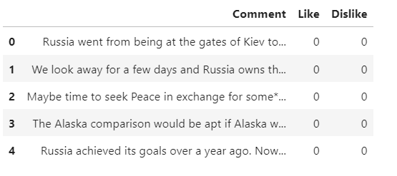
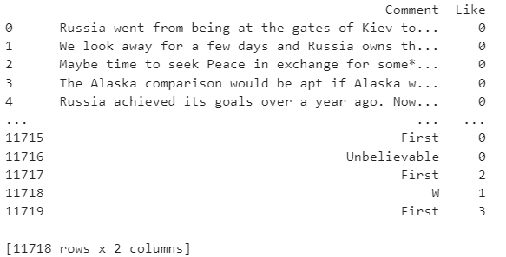
Methodology
Data Collection
In this project, YouTube comments were collected using the YouTube Data API v3.The project utilized the googleapiclient library to interact with the API.
Comments were extracted from specific videos identified by their video IDs

Slide 5
Methodology
Data Preprocessing
Our preprocessing scripts include several other essential steps to prepare the collected data for further analysis. These steps encompass the cleansing and structuring of the dataset to facilitate meaningful analysis
Comment Filtering – Lowercasing, Remove non alphanumeric data, urls, emojis, Non-English comments
Tokenization – Bigrams & Trigrams, Remove stop words, Lemmatization, POS Tagging, TF-IDF

Slide 6
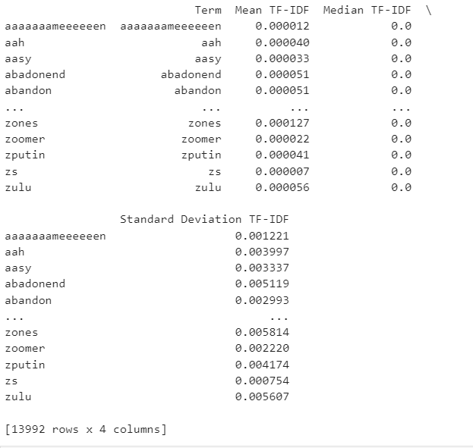
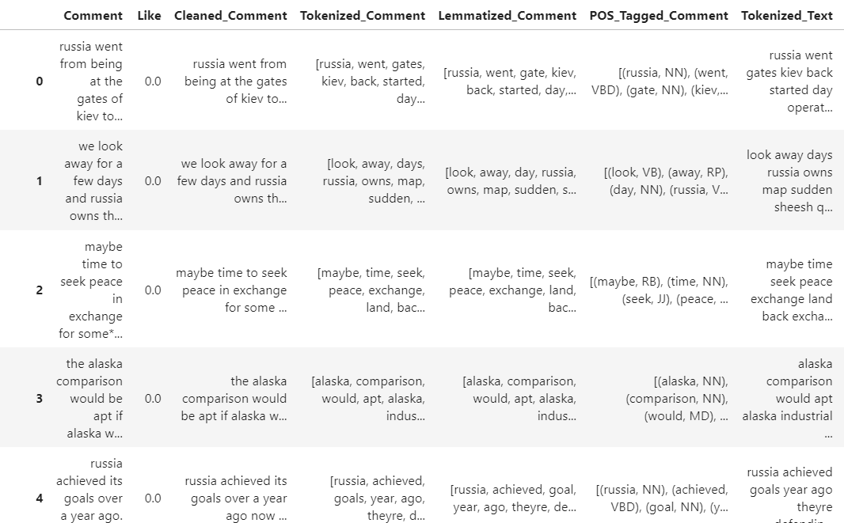
Methodology
Data Preprocessing
Processed Comments & TFIDF Feature Extraction

Slide 7
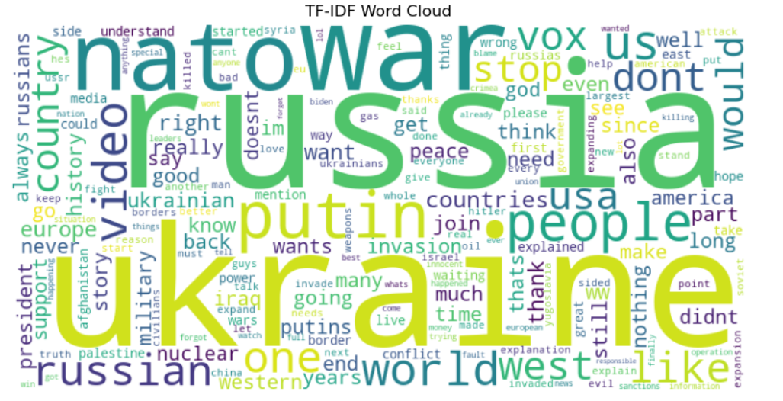
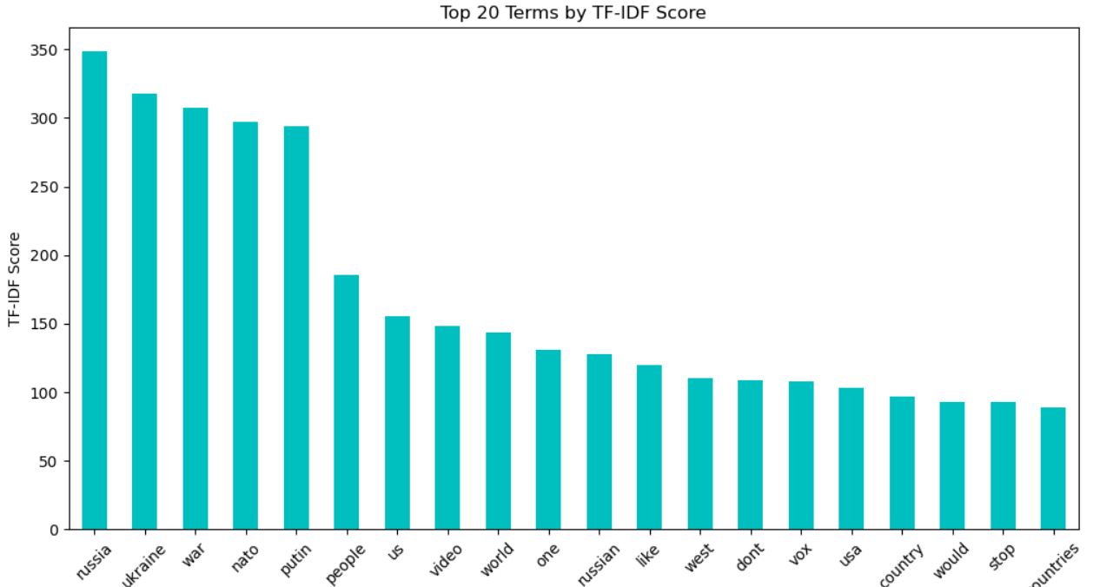
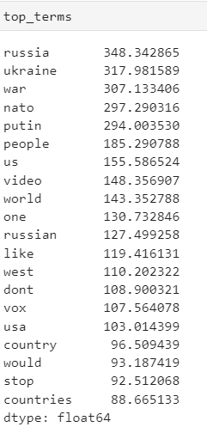
Exploratory Data Analysis
TF-IDF Visualization – Utilized TF-IDF to quantify term importance in YouTube comments. Visualized results through a Word Cloud and Bar Chart.

Slide 8
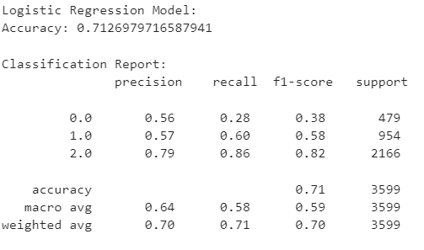
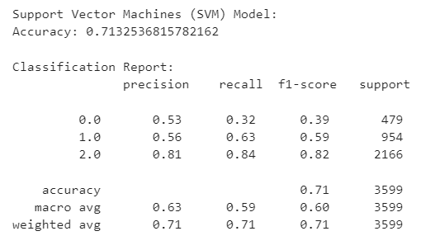
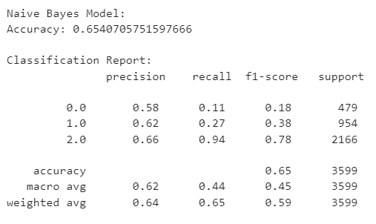
Sentiment Analysis Models:
Utilized a pre-trained model on cleaned comments to predict sentiments in the YouTube comments dataset
Logistic Regression Model : Accuracy 0.71
SVM : Accuracy 0.71
Naïve Bayes Model: Accuracy 0.65

Slide 9
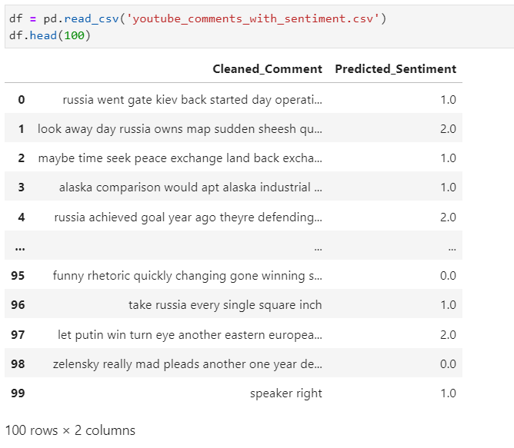
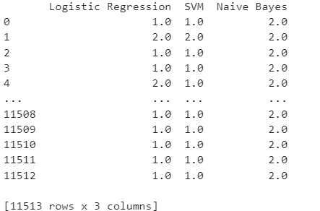
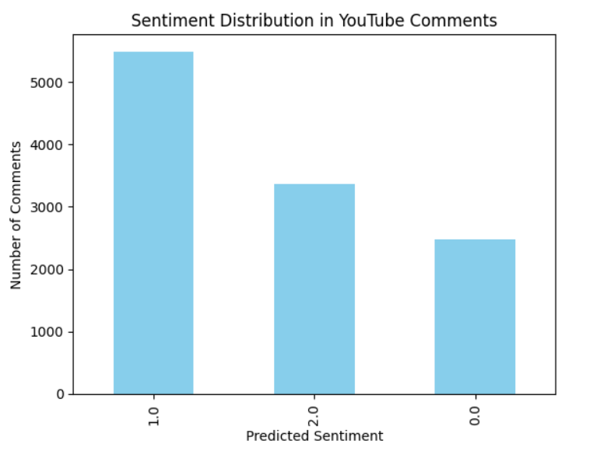
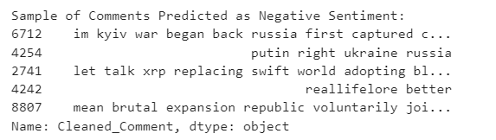
Predicting Sentiments for YouTube Comments
Leveraged pre-trained models (Logistic Regression, SVM, Naive Bayes) to predict sentiment labels for each YouTube comment.
Combined predictions using a majority vote strategy. Assigned the predicted sentiment label that received the majority of votes.

Slide 10
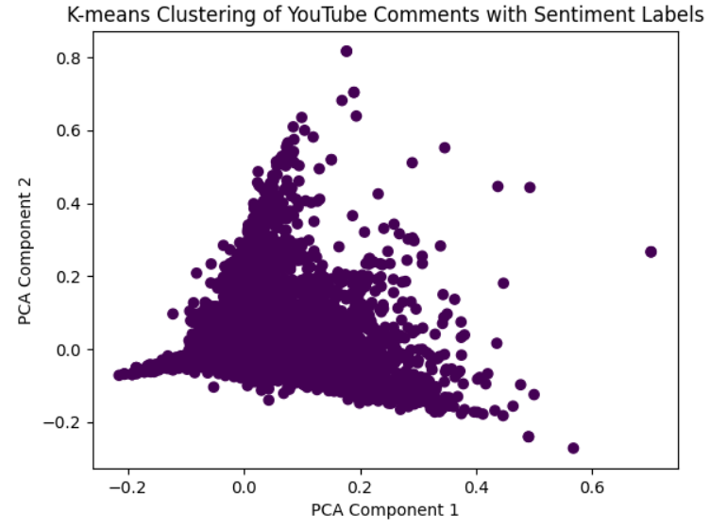
Text Clustering
Applied K-means clustering to YouTube comments using TF-IDF features.
Applied K-means clustering to categorize comments into three clusters.
Reduced dimensionality using PCA for clear 2D scatter plot visualization.

Slide 11
Conclusion:
The project provided comprehensive insights into audience sentiments on the Russia-Ukraine conflict, leveraging YouTube comments as a valuable source of diverse opinions.
Pretrained sentiment analysis models demonstrated adaptability to YouTube comments, showcasing their effectiveness in analyzing sentiments beyond the initial training dataset.
Challenges such as diverse language use and potential bias were acknowledged, paving the way for future improvements and refinements in sentiment analysis techniques.
The project successfully navigated the complexities of sentiment analysis on YouTube comments, shedding light on audience sentiments related to the Russia-Ukraine conflict.

Slide 12
Future Work:
Train sentiment analysis models specifically tailored to the domain of YouTube comments. Fine-tuning models on a dataset containing comments from various YouTube channels may yield better results for the platform's unique language and context
Develop a system for real-time sentiment monitoring of YouTube comments. This could involve streaming data analysis to capture changing sentiments as new comments are posted.
Explore methods to incorporate information from other modalities, such as analyzing sentiments from both text and images within YouTube comments. This could provide a more comprehensive understanding of user sentiment.
Consider analyzing sentiments at the user level to identify patterns and preferences among different user segments. This could help content creators tailor their strategies based on audience demographics.
Develop techniques to better handle sarcasm, irony, and other forms of figurative language present in YouTube comments, as these can significantly impact sentiment analysis accuracy.

Slide 13
References:
Agarwal, A., Xie, B., Vovsha, I., Rambow, O., & Passonneau, R. (2011). Sentiment analysis of Twitter data. Proceedings of the Workshop on Language in Social Media, 30-38.
Liu, B. (2012). Sentiment analysis and opinion mining. Synthesis Lectures on Human Language Technologies, 5(1), 1-167.
https://developers.google.com/youtube/v3/getting-started

Slide 14
THANK YOU
Stevens Institute of Technology
1 Castle Point Terrace, Hoboken, NJ 07030

